Slide 1
Conceptual U/G Drainage System
사외비
Internal Use Only
사우디 Safaniyah PKG No.1 Hydrocarbon Trains Project
지반구조설계팀
【 Contents 】
Drainage System
Piping Material Class
2022-12-28

Slide 2
1. Contents
1. Drainage System
1) Clean Storm Water Systems (CSW) – By Gravity
2) Oily Water Drainage Systems (OWDS) – By Gravity
3) Sanitary Wastewater Systems (SWS) – By Gravity
4) Closed Drain System (CLD) – Refer to SAES-A-401
5) Chemical Wastes
2. Piping Material Class
* COM-A-SM-070015_Rev D COMMON WASTEWATER DRAINAGE PHILOSOPHY

Slide 3
1. Drainage System
1) Clean Storm Water Sewer (CSW) – Main Source
  The CSW system shall only receive surface water run-off which is of a suitable quality for discharge to surface water systems without treatment. This will include:
  Areas which are reliably clean and remote from the process units and not at risk of contamination during normal operations, maintenance, rainfall or fire fighting (including roads); and
  Overflows from reliably clean water storage tanks such as raw water, firewater, drinking water, demineralized water and irrigation water.
  The CSW system shall not receive:
  Continuous or intermittent wastewater discharges from any process or utility equipment or the sanitary wastewater systems except where specifically identified within this philosophy document as a reliably clean discharge which can be routed to the CSW system.
  Light road vehicle parking areas (i.e. other than tankers)
* COM-A-SM-070015_Rev D COMMON WASTEWATER DRAINAGE PHILOSOPHY

Slide 4

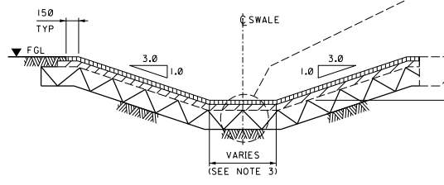
1. Drainage System
1) Clean Storm Water Sewer (CSW)
  Clean Storm Water -> Asphalt Concrete Swale -> C/B -> M/H -> CSW Pond
  CSW Pond (south - west side, 향후 pond No. 기재)
  → Gas Compression and Treatment (Unit S92-1), GOSP (Train 2, Unit S91-1), GOSP (Train 1, Unit S90-1)
  CSW Pond (south - east side, 향후 pond No. 기재)
  → WOSEP (Unit S94-1), Crude Storage & Shipping (Unit S90-2), Pipeline HUB (Unit S90-3)
Non-Process Area
(Clean Storm Water)
Battery Limit
Asphalt con’c Swale
CB
Sealed MH
Sealed MH
CSW POND
Pond 번호 기재 2개)
UG Piping
UG Piping

Slide 5
1. Drainage System
2) Oily Water Sewer (OWDS/OWS) – Main Source
  Streams from Plot / Risk areas that comply with the following may be discharged to the OWDS:
  After draining of equipment inventory into CDS, residual inventories of flammable and combustible liquids and high health hazard materials shall be flushed with water for a minimum of three volume flushes (water shall not react with material). After the flush less than 0.1 m³ (26 US gallons) from equipment may be drained to the OWDS. (Refer to SAES-A-400 Section 5.4, etc. for draining and flushing requirements prior to discharge to OWDS)
  Maintenance wash down which does not present a hazard to operators in the area, e.g. due to exposure to the vapors or slipping hazard
  Mildly-contaminated, high-flow, intermittent wastewater streams such as contaminated steam system condensates (subject to the temperature limit).
  Overflows from reliably clean water storage tanks such as wash water, firewater, potable water, irrigation water and dealinated/demineralized water tanks
  Used fire fighting water run-off (any condition).
  Surface Drainage such as all building, substaions, power poles, towers, access roads, diked or racked incoming and outgoing hydrocarbon lines, on-site pipe ways, flares and process equipments (SAES-S-020 para 4.3)
  Light road vehicle wash down areas with kerbed
* COM-A-SM-070015_Rev D COMMON WASTEWATER DRAINAGE PHILOSOPHY

Slide 6

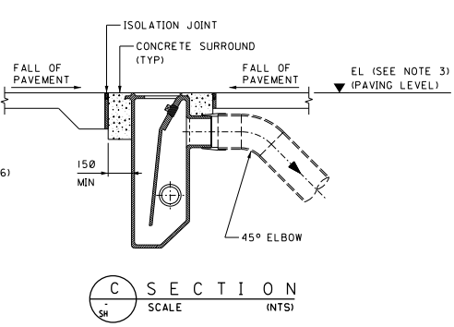
1. Drainage System
2) Oily Water Sewer (OWDS/OWS)
  CB for Process Paved Area / Spill Wall / Base Plate or Skid Drain -> U/G Piping -> M/H ->Tie-in Oily Lift Station (By Others)
  Equipment Drain Funnel 관련 배관 재확인 요함
  Each T/R Pit of Substation(320/321 Unit) -> U/G Piping -> Collecting Sump Pit(by Vacuum Truck)
S90-S-SM-393227 TYP ISO View 참조하여 배관 협의 요함
Battery Limit
Paved Area
Vent
SONO02
Vent
Clean Out
Sealed MH
Sealed MH
Oily Lift Station2
CB
UG Piping
UG Piping
S93-S-0702
T/R Pit
Valve(Open)
Collecting Sump Pit
Substation
T/R Pit
UG Piping
T/R Pit

Slide 7
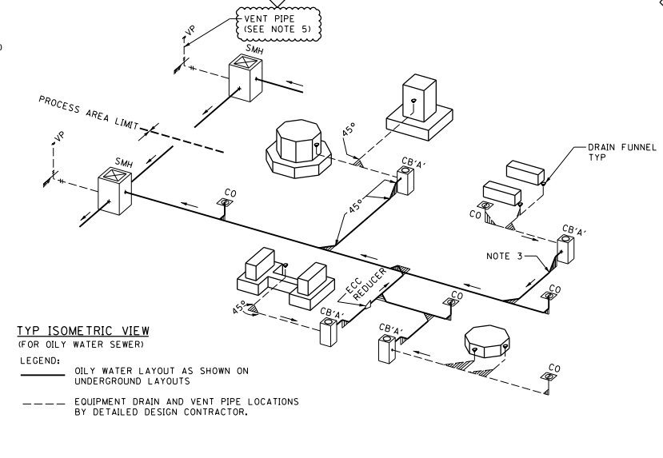

Slide 8
1. Drainage System
3) Sanitary Sewer (SWS) – Main Source
  Streams that comply with the following may be discharged to the SWS system:
  Domestic wastewater with organic and faecal contamination
  Wastewater from kitchens (provided that such is routed via a grease trap)
  Wastewater from laboratories (limited to rinse water from sinks provided that water at risk of acidic discharges is routed via a neutralization pit).
* COM-A-SM-070015_Rev D COMMON WASTEWATER DRAINAGE PHILOSOPHY

Slide 9
1. Drainage System
3) Sanitary Sewer (SWS)
  Operator Shelter (S92-B-9201, 9101, 9001, 9401) -> U/G Piping -> Sanitary Lift Station (S93-S-0717, 0718, 0726, 0727)
Pumping
Operator Shelter
MH
MH
Sanitary Lift Station
UG Piping
S93-S-0727
S93-S-0726
S93-S-0718
S93-S-0717

Slide 10
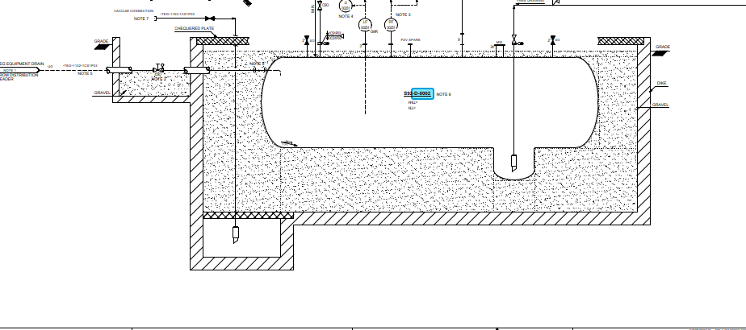
1. Drainage System
4) Closed Drain (CDS) – Main Source
  Closed Drain System (CDS) shall be provided for draining process vessels and process equipment (e.g., exchangers, pumps, piping and header, instrumentation, control valves, compressor casing, and compressor cylinder and pulsation dampener drains) for liquids described in paragraph 1.2.
  대부분 Above Pipeline 구성, TEG Closed Drain 은 UG (향후 재확인 요함)
* SAES-A-401 Closed Drain System (CDS)
HOLD
PID SM-250060

Slide 11
1. Drainage System
4) Closed Drain (CDS)
  TEG Closed Drain System –TEG Closed Drain Drum Pit location 및 SOW 확인 후 UG Pipe Trench inform 배관 확인 요함
HOLD
Pumping
Pipe Trench
w/Sand Filling
TEG Closed Drain
(HC Closed Drain Sump)

Slide 12
1. Drainage System
5) Chemical Wastes – Laboratory & Battery Rooms
  Battery Rooms
  Sinks / wash down areas / drains in battery rooms shall only be used to wash minor contamination to drain, e.g. wash down after topping up with distilled water or battery acid. Drainage from battery rooms shall be routed to a sump via a neutralization tank.
  Laboratory Drainage
  The laboratory shall operate a system of segregated type-specific sample waste collection drums and containers for disposal of contaminated liquid laboratory wastes.
  Laboratory sinks shall be routed to the sanitary wastewater drainage systems (SWS). Where there is a risk of acidic wastes, the laboratory sinks shall be routed to the SWS via an acid neutralization pit.
* COM-A-SM-070015_Rev D COMMON WASTEWATER DRAINAGE PHILOSOPHY

Slide 13
1. Drainage System
5) Chemical Wastes – Laboratory & Battery Rooms
  Laboratory
    - Laboratory (Operator shelter (S92-B-9201)) -> UG Pipe -> Neutralization Pit -> SWS
  Battery Rooms
    - Battery Room (Security Support Building**/Substation(SS220501) -> UG Pipe -> Neutralization Pit (by Vacuum Truck)
Pumping
Laboratory
Neutralization Pit
SWS MH
Sanitary Lift Station
UG Piping
UG Piping
UG Piping
S93-S-0727
S93-S-0726
S93-S-0718
Battery Room
Neutralization Pit
OWS MH
UG Piping
UG Piping

Slide 14
1. Drainage System
5) Chemical Wastes – HVAC Buildings
  HVAC MECHANICAL BUILDINGS
  Drainage from HVAC mechanical building floor drains shall be routed to the nearest convenient drainage system in the following order of preference (1 = first preference, 2 = last preference, only if first preference not viable):
  1. SWS without oil interceptor trap
  2. Soak pit outside the building
  Clean condensate from HVAC may be discharged to the SWS or soak pit.
* COM-A-SM-070015_Rev D COMMON WASTEWATER DRAINAGE PHILOSOPHY

Slide 15
1. Drainage System
5) Chemical Wastes – HVAC Buildings
  HVAC Buildings
    - HVAC Buildings -> Piping -> Soak Pit
TBD
Soak Pit
HVAC Buildings
Piping

Slide 16
2. Piping Material Class
U/G Civil Piping Material Class
Fluid Service Code | Piping Class | Material | Remarks
Clean Storm Water (CSW) | N/A | Reinforced Concrete Pipe | 토목BM Sheet 산출
Oily Water Sewer (OWS) | 80FE0D | RTR | 배관팀 송부
Sanitary Water Sewer (SWS) | 80FE0D | RTR | 배관팀 송부
Sewer Vent Piping | 80CG0D | Galv. CS (1CH2P06) | 배관팀 송부
L-104 Table 11.1
* RTR : Reinforced Thermosetting Resin Plastic

Slide 17
3. 기타
1) CWS / CWR / FW
2) Deep Sump / Big Basin
  420-BA-0002_Storm Water Lift Station
  500-BA-0001_Oily Water Holding Pit
3) Pile 적용 Civil Item
  320/321-C-5041_Dehexanizer
  320/321-C-5061_Deethanier
  320-K-0001_Ethylene Booster Compressor
TO BE UPDATED

